Slide 1
Digitalized certificate generation of emission test
DOMAIN : Internet Of Things
GUIDE DETAILS:
P.Deepa M.E.
Associate Professor,
Department of CSE,
Panimalar Engineering College
211417104263 - Sonika.M
211417104274 - Sujeetha.B
211417104286 - Vaishnavi.G

Slide 2
Introduction
Nowadays,the most common problem faced is that there is a huge increase in pollution.This is because of an increased diesel engine population has created pressures on controlling diesel PM and NOx emissions.
Emission standards implemented in 2005-2010 timeframe additionally require the use of exhaust after treatment methods on new diesel engines.This is where pollutants such as NOx,CO and PM are created which leads to incomplete oxidation of fuel combustion.
To avoid such toxic pollutants,our idea is to develop a system called “Digitalized Certificate Generation Of Emission Test”,which will be useful to monitor the emission of the vehicle.
Firstly, air pollution sensors are used. This sensor will detect gases such as ammonia, sulphur, benzene vapor and other harmful smoke. Sensor ADC count below 200 is taken as normal where as above this value is taken as abnormal. Then, microcontroller such as AVR will be used to process the readings from those sensors and Wi-Fi gateways are used for pushing those data to the mango dB database using application program interface.
Secondly,a web application will be developed to monitor the abnormal emission of the vehicle and a mobile application will be developed using react native to get abnormal emitting vehicle information.
Finally, a certificate will be automatically generated and send through mail.Thus,this project will be useful to identify the pollution emitting vehicle easily and can control the air pollution.

Slide 3
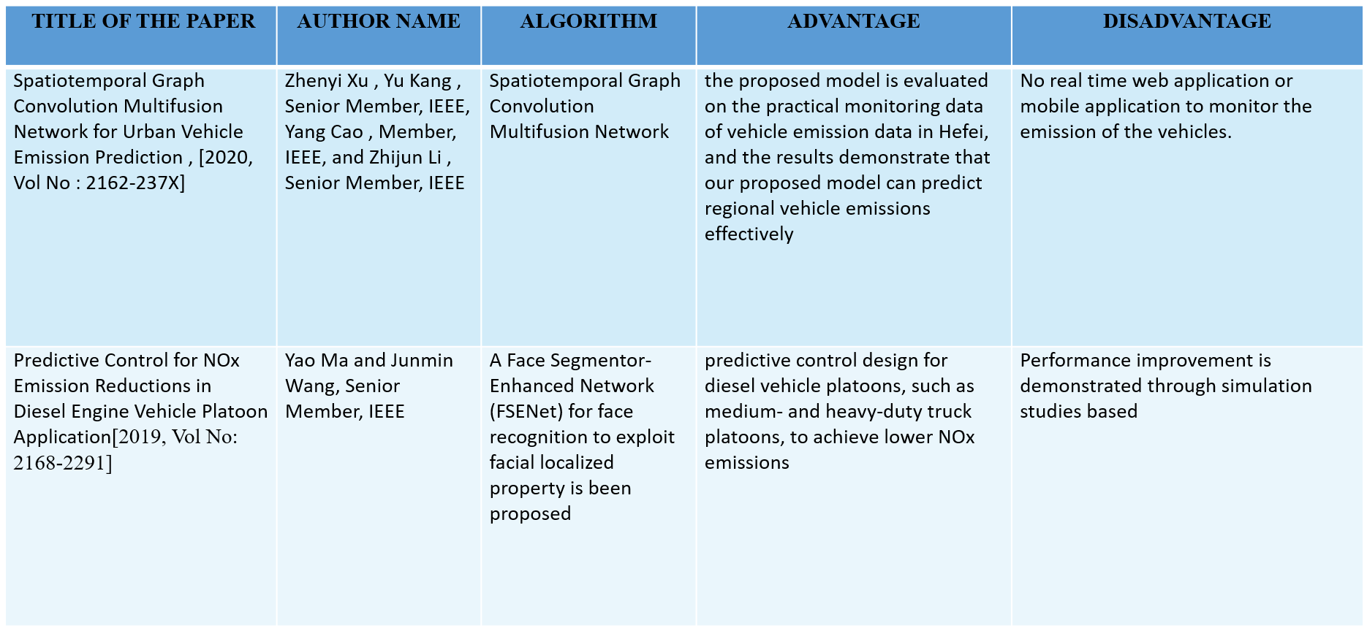
Literature survey

Slide 4
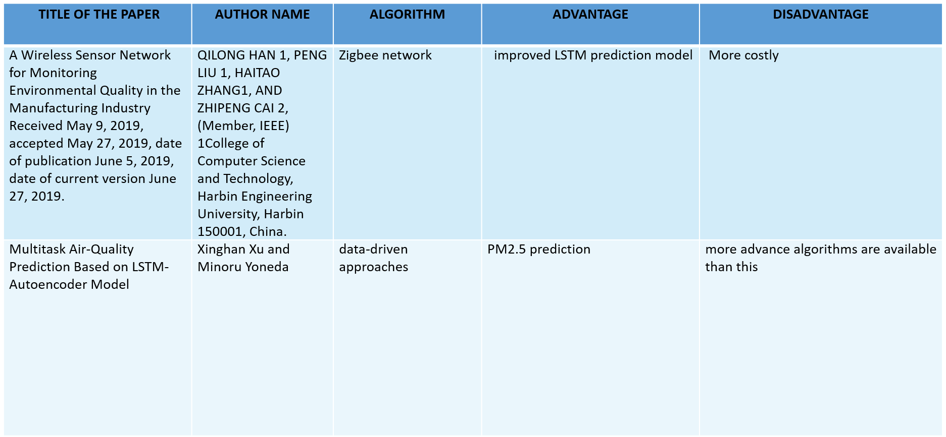
Literature survey

Slide 5
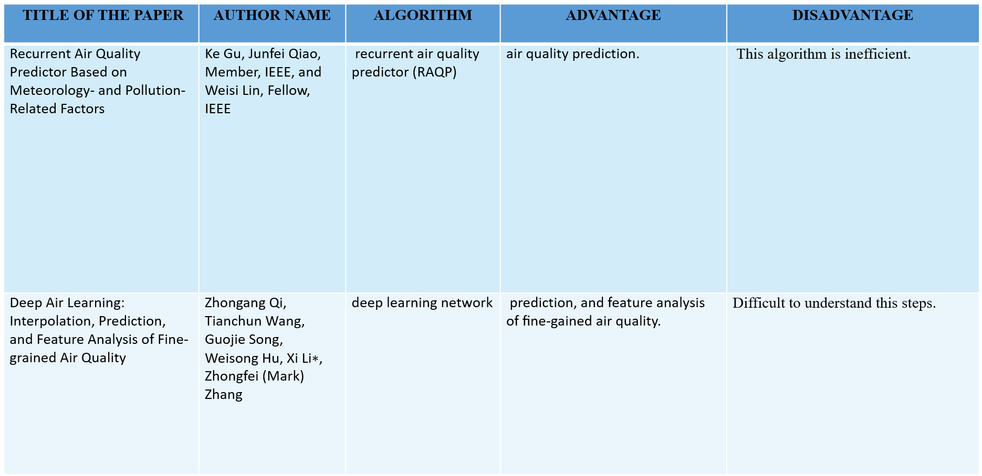
Literature survey

Slide 6
Problem Statement
Lack of automated system to monitor emission in vehicles and Fake emission control certificates are issued through bribing. This leads to air pollution in the environment.
There is no technological solution to this problem.

Slide 7
Technology stack
HARDWARE REQUIREMENTS:
PC
Power Supply
Air Pollution Sensor
GPS
Micro Controller
Wi-Fi Module
RAM : 8 GB
Processor : i5
Hard Disk : 1 TB
SOFTWARE REQUIREMENTS:
Visual Studio
Python

Slide 8
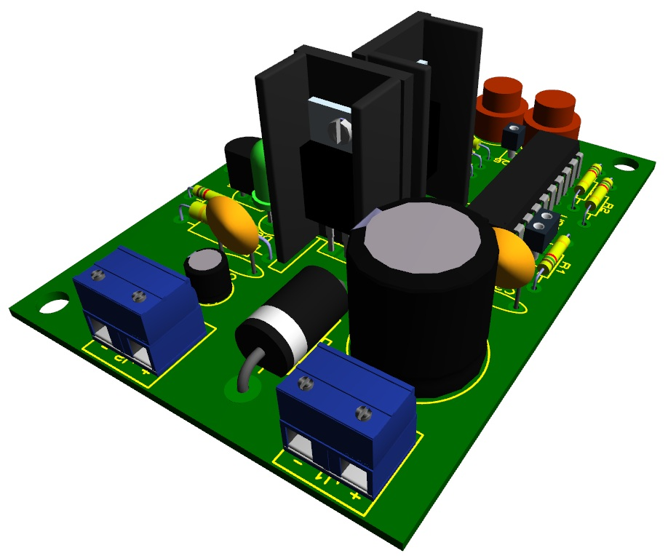
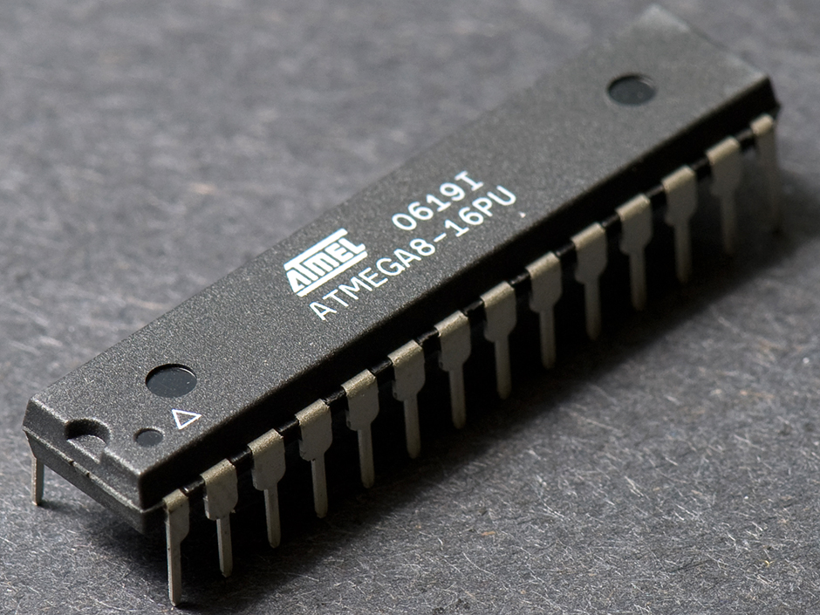
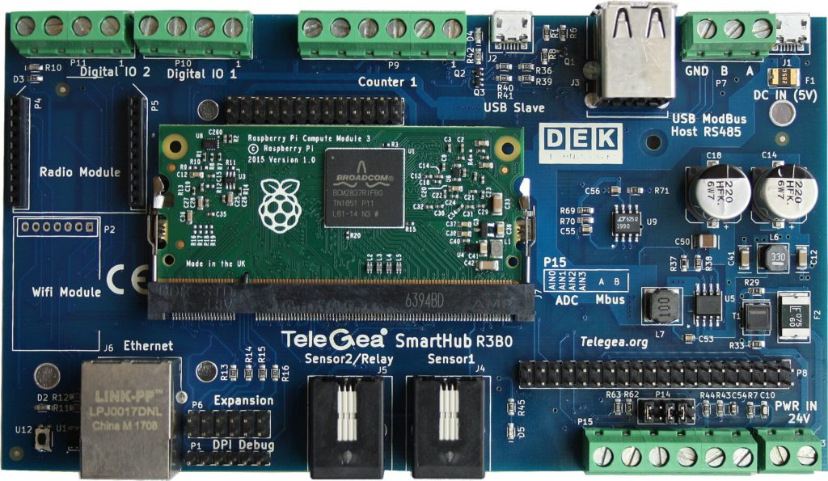


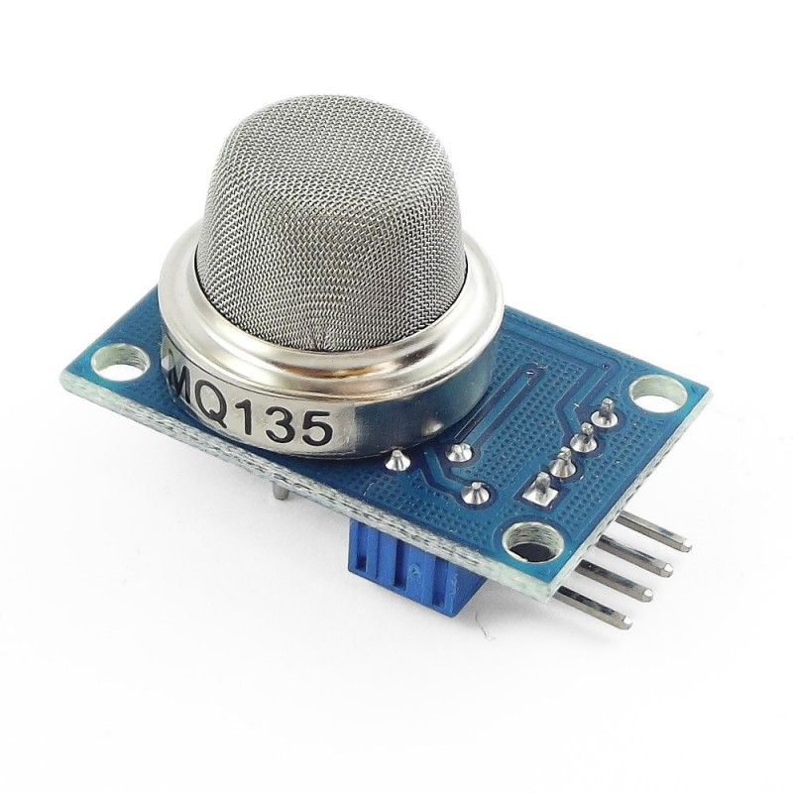


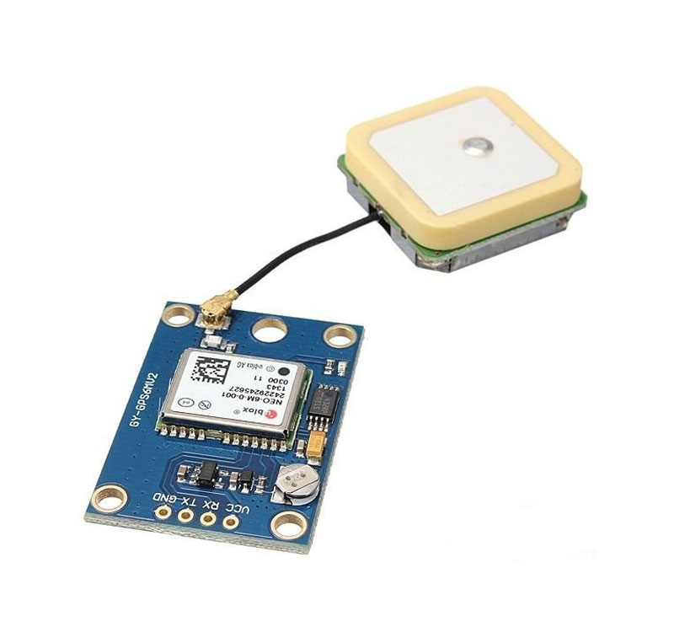
System architecture
GATEWAY MODULE
POWER SUPPLY
DATABASE INTEGRATION
MICROCONTROLLER
MOBILE APPLICATION DEVELOPMENT
WEB APPLICATION DEVELOPMENT
AIR POLLUTION SENSOR
GPS MODULE

Slide 9
SYSTEM DESIGN
GET DATA FROM VEHICLE
SEND INFORMATION TO DATABASE
INTEGRATE WIFI MODULE
FETCH DATA FROM DATABASE
APPLY MQTT PROTOCOL
EMISSION CONTROL WEB APPLICATION
MOBILE APPLICATION NOTIFICATION
CHECK AIR POLLUTION THRESHOLD
SEND DATA TO POLICEMAN
ABNORMAL
NORMAL
IGNORE
YES

Slide 10
ER DIAGRAM
LOGIN
ADMIT
LOGIN
ADMIN
USER VEHICLE DATA
GENERATES REPORT OF VEHICLE POLLUTION
THRESHOLD CROSSED
TRACK LOCATION
YES
SEND ALERT
NO
IGNORE
POLICE APP
SEND GPS DATA

Slide 11
UML DIAGRAM – USECASE DIAGRAM
LOGIN
INPUT DATA
ADMIN
STORES DATA IN DATABASE
CHECK
VALUES
USER
SEND ALERT
IGNORE
GET VALUE
SENDS GPS
LOCATION
TRACK
LOCATION

Slide 12
UML DIAGRAM – SEQUENCE DIAGRAM
HARDWARE KIT
EMISSION WEB PAGE
POLICE MOBILE APP
Notify the police
Collect
information
from sensor
Starts the class admitting users
Integrate GPS
Ignore/send notification
Integrate
WIFI gateway
Check for abnormality
Fetch data
Send data to database
Track GPS
location
Track location
Send GPS location to police app

Slide 13
Types of modules
Processing Module
Gateway Module
Database Integration
Web Application Development
Email Integration
Mobile Application Development

Slide 14
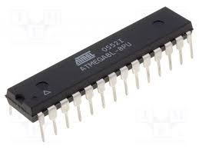
Processing module
We will be using ATmega-328 (AVR) micro-controller to collect the data from the air pollution sensor.
ATmega-328 is basically an Advanced Virtual RISC (AVR) micro-controller.
It supports the data up to eight (8) bits. ATmega-328 has 32KB internal built-in memory. This micro-controller has a lot of other characteristics.

Slide 15
Gateway module
We will be using the ESP8266 gateway module, which collects the data from the AVR Microcontroller and sends them to the web application wirelessly.
The ESP8266 is a low-cost Wi-Fi chip with full TCP/IP stack and MCU (microcontroller unit) capability.
The very low price and the fact that there were very few external components on the module which suggested that it could eventually be very inexpensive in volume, attracted many hackers to explore the module.
The successor to these microcontroller chips is the ESP32. ESP8266 (presently ESP8266EX) is a chip with which manufacturers are making wirelessly networkable micro-controller modules.

Slide 16
Database integration
MongoDB ,an open-source cross-platform document-oriented database program is used for database management.
Database is a physical container for collections. Each database gets its own set of files on the file system. A single MongoDB server typically has multiple databases.
Collection is a group of MongoDB documents. It is the equivalent of an RDBMS table.
A document is a set of key-value pairs. Documents have dynamic schema. Dynamic schema means that documents in the same collection do not need to have the same set of fields or structure, and common fields in a collection's documents may hold different types of data.

Slide 17
Web application Development
React JS is a JavaScript library used in web development to build interactive elements on websites (User Interfaces), it is maintained by Facebook React makes it effortless to create interactive UIs.
Due to its many advanced features like Virtual DOM, Interactive interfaces, Easy-to-use, Alternatives to other libraries, SEO friendly, Flexible Development, Quick access to developers this is been used for developing the web application.
A database will be managed using which the prediction process happens in the backend and the result is been fetched through the web application.

Slide 18
Email integration
We are using email integration and SMTP protocol.
For integrating email we will be using the SMTP protocol which is used for sending and receiving mail as configured by us.
In this project, we are going to send an email via SMTP server.
SMTP works by starting a session between the user and server, whereas MTA (Mail Transfer Agent) and MDA (Mail Delivery Agent) provide domain searching and local delivery services. Previously, we have send SMTP email using ESP8266 NodeMCU.
Ex:The Number of students present/absent will be recognized and automatically the mail will be send to the register mail ID.

Slide 19
Mobile app development
React Native is a framework that builds a hierarchy of UI components to build the JavaScript code.
It has a set of components for both iOS and Android platforms to build a mobile application with a native look and feel.
React Native seems to be a viable solution for building high-quality apps in a short time with the same performance and user-experience standards that native apps provide.
React Native apps are compiled into natively written code, which enables React Native to not only work on both operating systems, but also have same features on both platforms with no lag.

Slide 20
Testing & Performance analysis
TESTCASE1 - LOGIN TEST - The user must be able to create a proﬁle, and if they already have a proﬁle, emission control department must be able to log-in and see their personal data. The test for this scenario is to check if the username is in proper format and credentials are validated.
TESTCASE2 - Initially, the kit is connected with air pollution sensor, microcontroller & GPS module and then power supply is given.To ensure whether the kit is connected with these sensors and microcontroller along with a efficient power supply.
TESTCASE3 – To check whether the air pollution sensor detecting the values correctly .The sensor ADC value below 200 is considered as normal whereas above 200 is considered as abnormal.Once the gases are detected ,those values will be stored in the web app and to admin needs to accept or decline based on the values obtained.
TESTCASE4 – To check whether those abnormal values & data of the vehicle is sent to the police App. And then,we also need to check whether the police is being able to view the details of the vehicle like where it is right now or not.

Slide 21
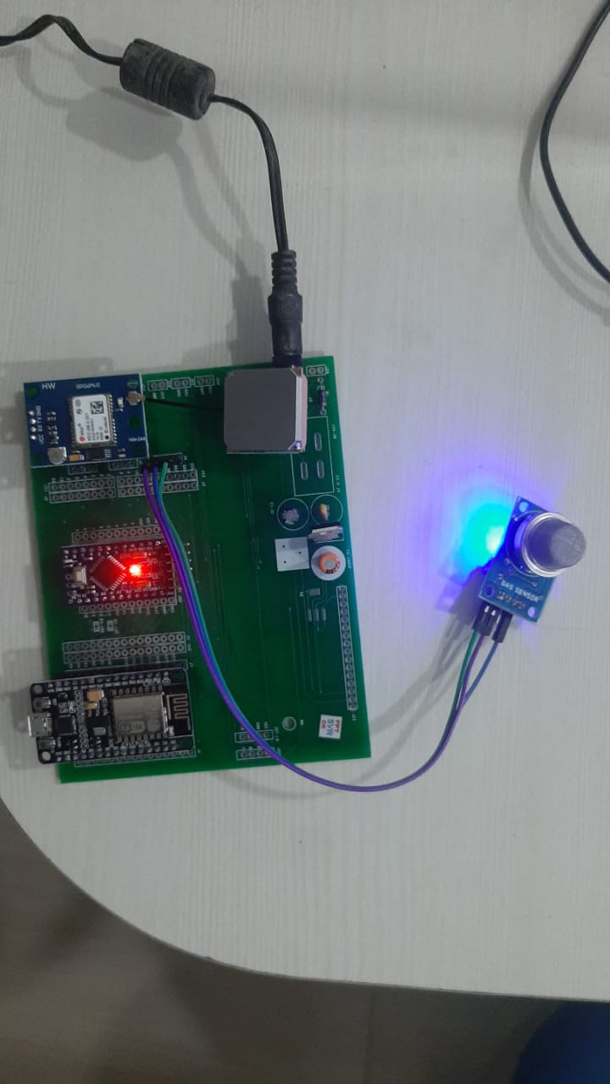
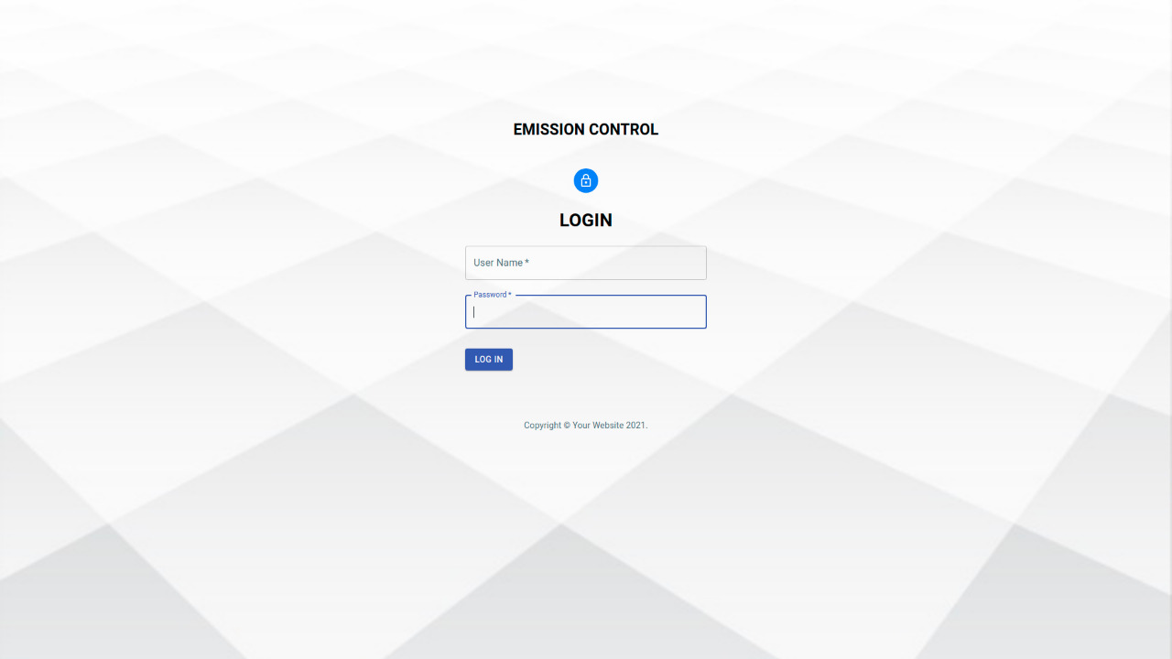
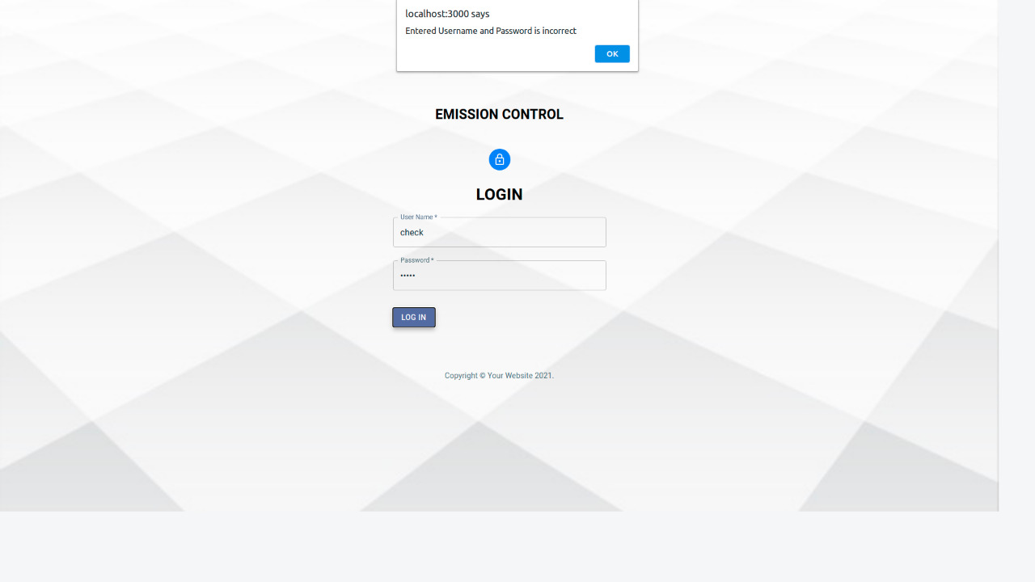
SCREENSHOTS OF WORK DONE
Kit connected with sensor, Login Page of Web App Invalid Login
AVR & GPS Module

Slide 22
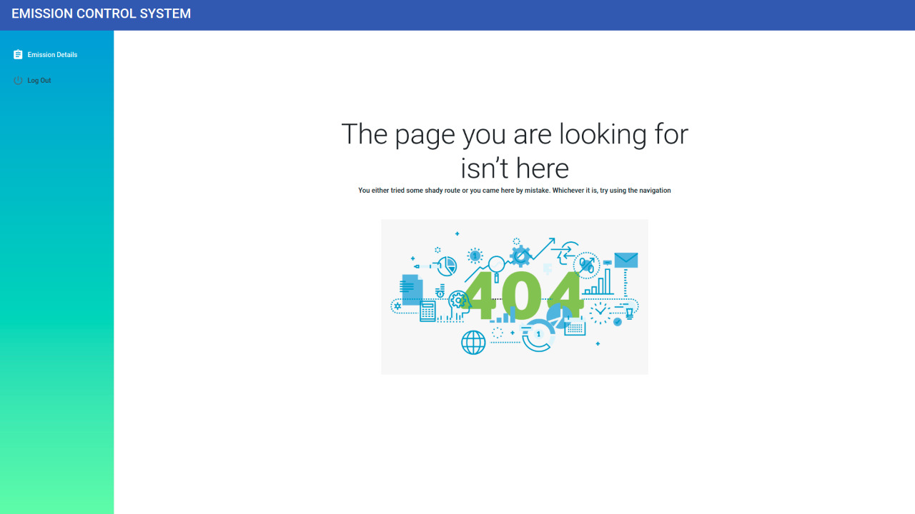
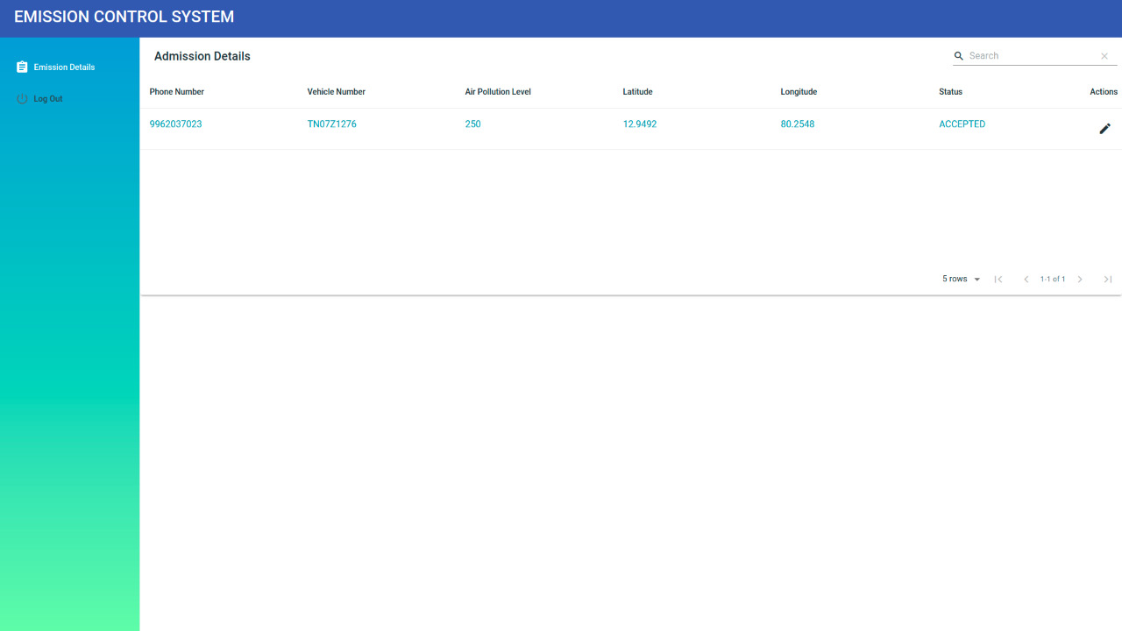
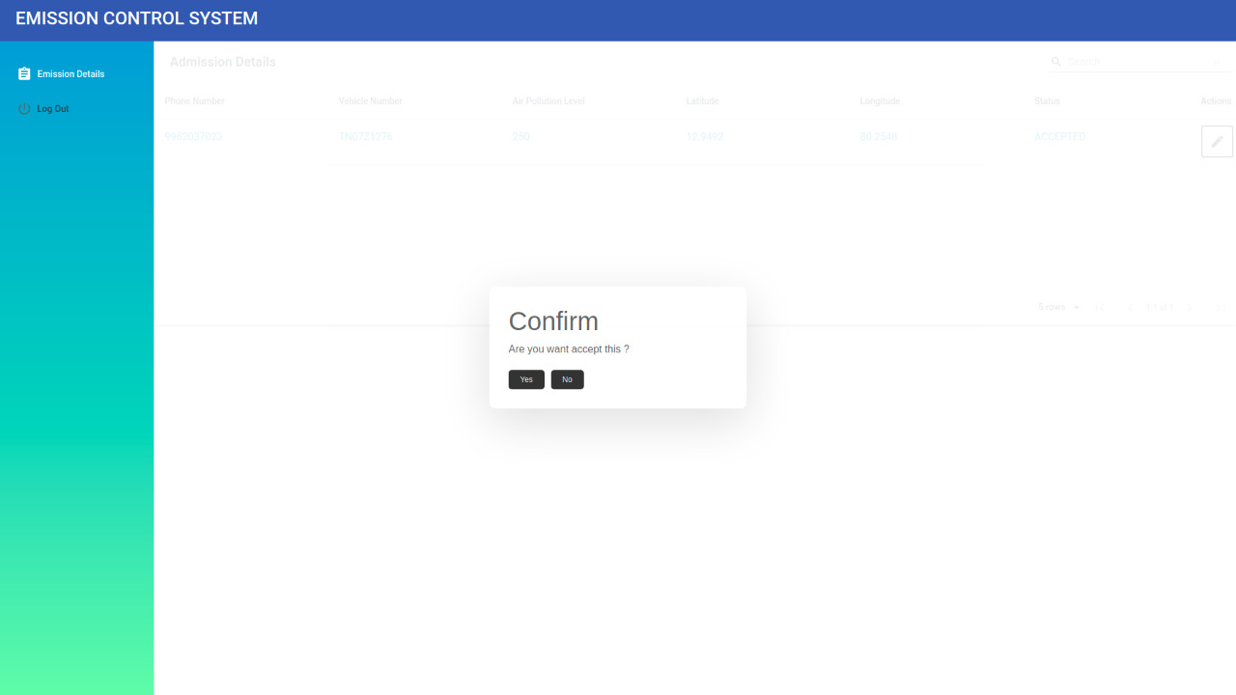
SCREENSHOTS OF WORK DONE
When Data is not Found Data Entered Accept or Reject

Slide 23
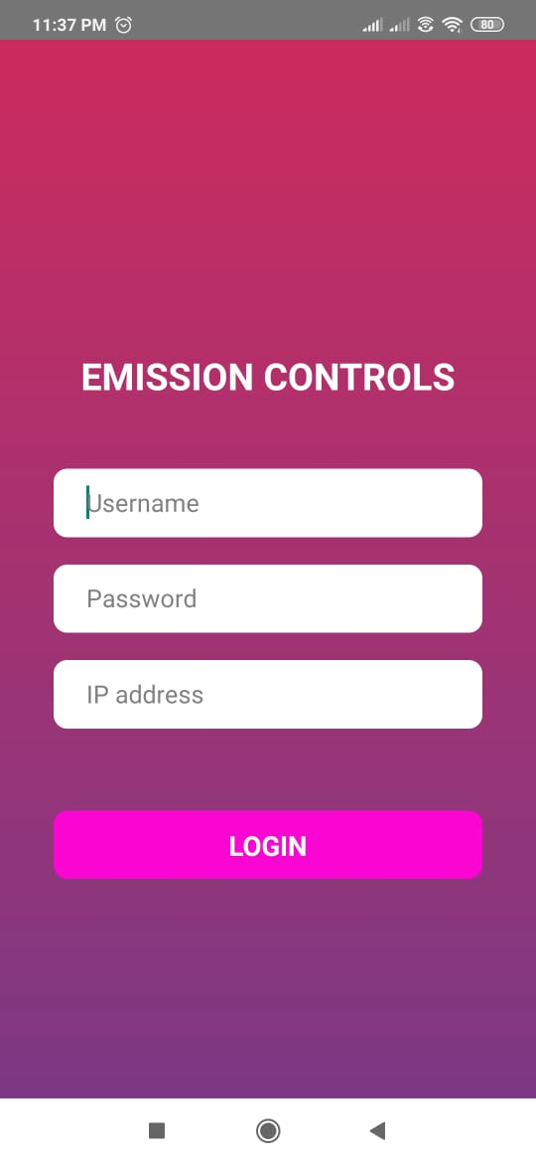
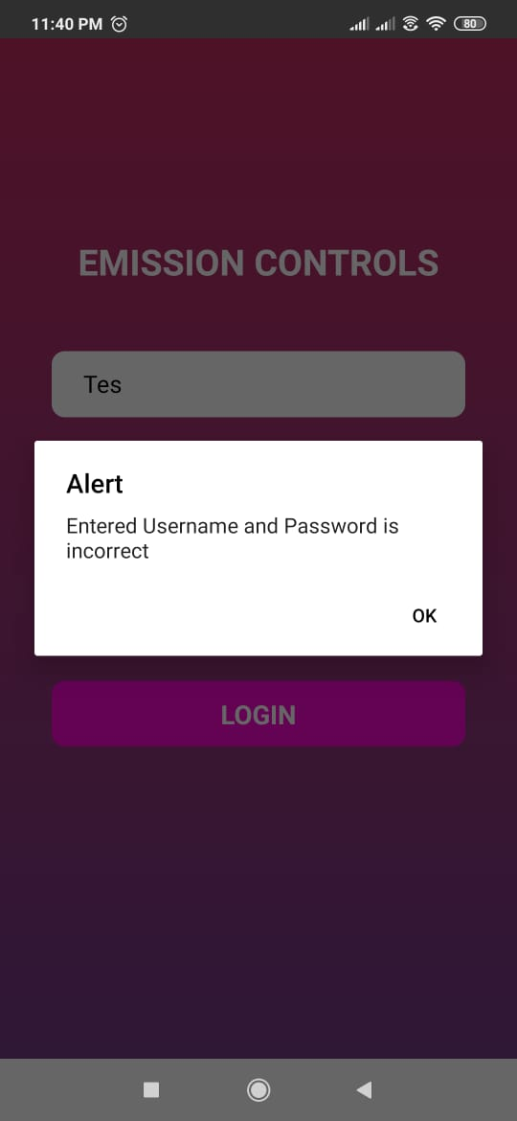
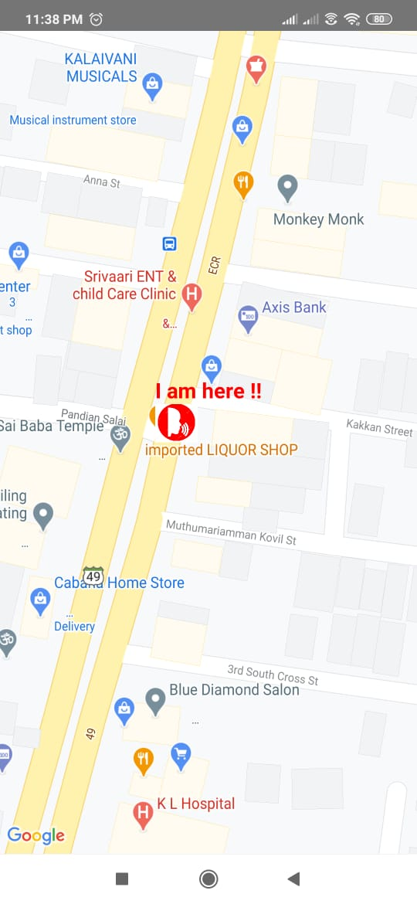
SCREENSHOTS OF WORK DONE
Login of Mobile App Invalid Login User Vehicle Tracking

Slide 24
Conclusion & Future Enhancements
It is used to identify the level of gases emitted from vehicles. It makes all the certificates digital to achieve paperless work and also maintain authenticated and authorized process. Managing the centralized system in simple and efficient way. This is the most secured contribution to smart city.
The IoT based emission test system is an efficient and reliable system that ensures that the data collected by the smoke sensors at the ETC is accurate and the integrity is maintained. The system addresses two important disadvantages of the existing system; firstly, the system induces automation and digitization. Secondly, the system ensures integrity and authenticity of data.
Future Scope : The proposed system has not implemented image processing at CA to verify the authenticity and hence requires an administrator to approve or reject the generation of the certificate. This feature can be considered for the future work.

Slide 25
reference
[1] An Automatic System for Unconstrained Video-Based Face Recognition, Jingxiao Zheng , Rajeev Ranjan, Ching-Hui Chen , Jun-Cheng Chen, Carlos D. Castillo, and Rama Chellappa
[2] Predictive Control for NOx Emission Reductions in Diesel Engine Vehicle Platoon Application[2019, Vol No: 2168-2291]
[3] QILONG HAN 1, PENG LIU 1, HAITAO ZHANG1, AND ZHIPENG CAI 2, (Member, IEEE) 1College of Computer Science and Technology, Harbin Engineering University, Harbin 150001, China “A Wireless Sensor Network for Monitoring Environmental Quality in the Manufacturing Industry” Received May 9, 2019, accepted May 27, 2019, date of publication June 5, 2019, date of current version June 27, 2019.
[4] Xinghan Xu and Minoru Yoneda “Multitask Air-Quality Prediction Based on LSTM-Autoencoder Model” IEEE Transactions On Cybernetics.
[5] Ke Gu, Junfei Qiao, Member, IEEE, and Weisi Lin, Fellow, IEEE “Recurrent Air Quality Predictor Based on Meteorology- and Pollution-Related Factors” IEEE Transactions on Industrial Informatics.

Slide 26
Thank you..!!!

